Slide 1
Web Engineering
Lab 5

Slide 2
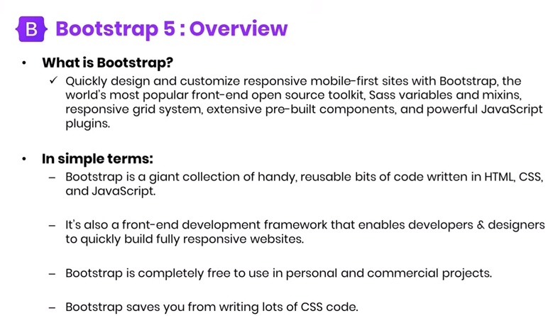
What is Bootstrap?

Slide 3
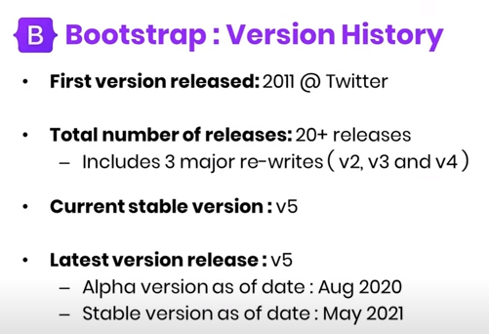
Bootstrap Versions

Slide 4
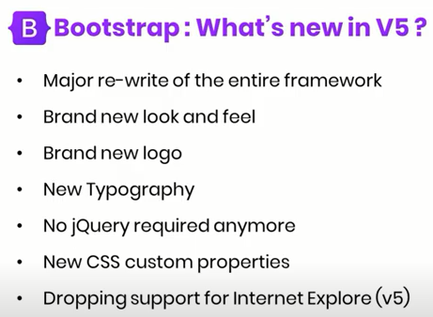
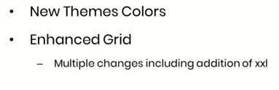
What’s New in V5?

Slide 5
Why Use Bootstrap?
Advantages of Bootstrap:
Easy to use: Anybody with just basic knowledge of HTML and CSS can start using Bootstrap
Responsive features: Bootstrap's responsive CSS adjusts to phones, tablets, and desktops
Mobile-first approach: In Bootstrap, mobile-first styles are part of the core framework
Browser compatibility: Bootstrap 5 is compatible with all modern browsers (Chrome, Firefox, Edge, Safari, and Opera)

Slide 6
How to Get Bootstrap 5?
There are two ways to start using Bootstrap 5 on your own web site.
Include Bootstrap 5 from a CDN (Content Delivery Network)
Download Bootstrap 5 from getbootstrap.com
https://www.youtube.com/watch?v=hVWqawyqNUk&list=PLdPwRNmUlk0ka9Woqt3Xz4YKr5Fy5wjQT&index=5

Slide 7
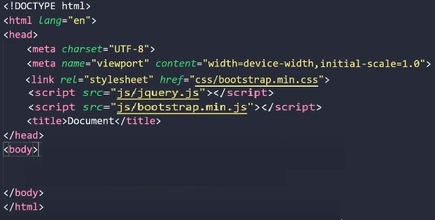

Create First Web Page With Bootstrap 5

Slide 8

Container Classes
There are two container classes.
The .container class provides a responsive fixed width container
The .container-fluid class provides a full width container, spanning the entire width of the viewport
https://www.youtube.com/watch?v=ceeRn8MQzPw

Slide 9
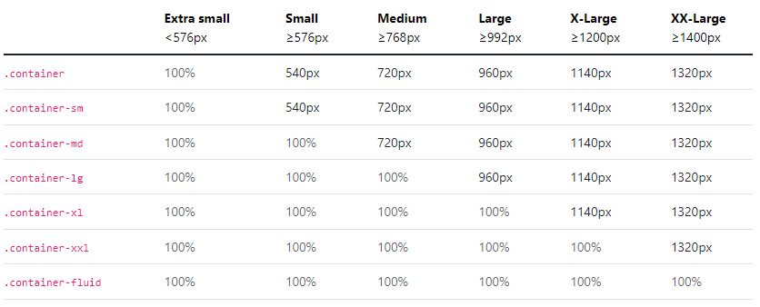
Container Layout
The Bootstrap 5 grid system has classes:

Slide 10
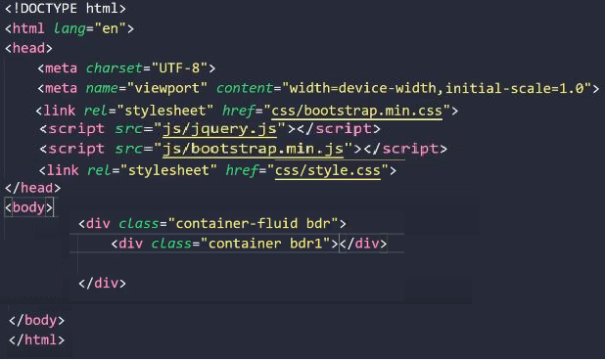
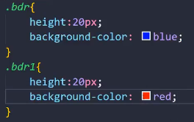

Slide 11
Bootstrap 5 Grid System
Bootstrap's grid system is built with flexbox and allows up to 12 columns across the page.
https://www.youtube.com/watch?v=dHmwopKe1xk

Slide 12
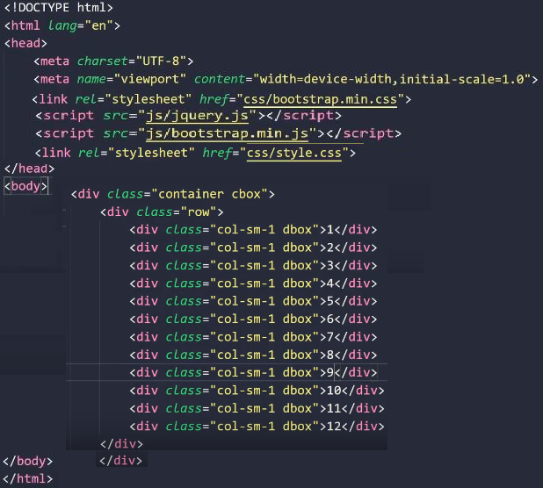
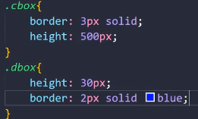
Bootstrap 5 Grid System

Slide 13
Assignment No#3
Bootstrap 5 Buttons
Bootstrap 5 Pagination
Bootstrap 5 Dropdowns
Bootstrap 5 Navigation Bar
Bootstrap 5 Forms
Bootstrap 5 Tables
Bootstrap 5 Carousel
Bootstrap 5 Progress

